Slide 1
Advanced Thermal & Vacuum Systems Engineering
Varad Lad
Manufacturing Design Engineer Candidate
KLA Corporation - SensArray Division

Slide 2
Engineering Excellence Across Semiconductor & Data Center Domains
• 5+ Years Experience: Mechanical Design, CAD Modeling, FEA/CFD Analysis
• Semiconductor Expertise: TSMC 4nm/2nm Fab Design, Thin-Film Deposition (CVD/PVD/ALD)
• Thermal Systems: Data Center Cooling Optimization, Vacuum Systems, HVAC Design
• Process Optimization: DOE, SPC, FMEA, Yield Improvement, Cost Reduction
• Technical Leadership: Cross-functional Teams, Stakeholder Management, Training
• Education: MS Mechanical Engineering, ASU Sun Award of Excellence

Slide 3
Data Center Advanced Thermal Optimization
CHALLENGE: Data center cooling consumes 50% of total energy with thermal stratification issues
SOLUTION: Comprehensive CFD analysis comparing air vs. liquid cooling strategies
• 3D Modeling: Fusion 360 rack design with modular cooling features
• CFD Simulation: SimScale analysis under realistic 10kW/rack loads
• Hot Aisle Containment: Optimized airflow management
• Adaptive Control: Smart thermal management strategies
RESULTS:
• 27% improvement in cooling performance
• 32% reduction in hotspots
• 15°C cooler inlet temperatures with liquid cooling
• PUE improvement from 1.5 to 1.1 (liquid-cooled hybrid)
• Scalable, cost-effective thermal management approach

Slide 4
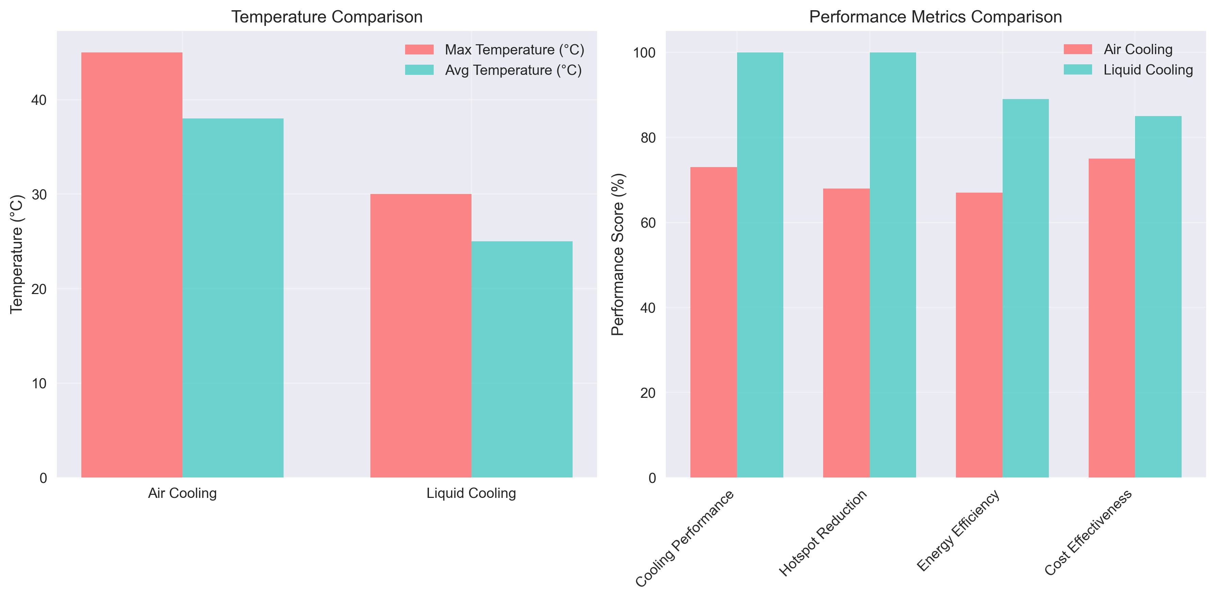
Thermal Performance Analysis: Air vs. Liquid Cooling

Slide 5
Thin-Film Deposition Process Optimization
TECHNICAL EXPERTISE: CVD, PVD, ALD Deposition Techniques
PROCESS OPTIMIZATION:
• DOE & SPC Analysis: JMP-based parameter optimization
• Metrology: SEM, TEM, XRD, UV-Vis characterization
• Defect Detection: 90% surface defect identification
• Film Uniformity: 12% improvement through parameter tuning
• Material Waste: 40% reduction via process optimization
YIELD IMPROVEMENT:
• 28% yield performance gain through thermal management
• 15% synthesis-stage purity improvement
• Big-data analysis of deposition variables and defect trends
• Predictive modeling for process optimization
RELEVANCE TO KLA SENSARRAY:
• In-situ thermal process control expertise
• Vacuum system optimization experience
• Process monitoring and control systems
• Yield improvement methodologies

Slide 6
N+1 Redundancy in Vacuum Systems (TSMC Experience)
CRITICAL FACILITY SYSTEM DESIGN:
• 4nm, 2nm Fab-Utility and Data Center Design
• N+1 Redundancy Planning with Operations Reliability Team
• $120,000 Future Maintenance Cost Savings
• 25% Equipment Downtime Reduction
VACUUM SYSTEM EXPERTISE:
• SCADA-based Diagnostics for Critical HVAC Systems
• Abatement System Failure Resolution
• Cleanroom Environment System Troubleshooting
• Cooling Towers and Chillers Optimization
QUALITY ASSURANCE:
• 0% Construction Rework Achievement
• P&ID and PFD Validation
• ICC, IBC, IFC, NFPA Code Compliance
• Power BI and Tableau Dashboard Development
RELEVANCE TO KLA:
• High Vacuum Systems Experience
• Process Control and Monitoring
• Equipment Reliability and Maintenance
• Cross-functional Team Leadership

Slide 7
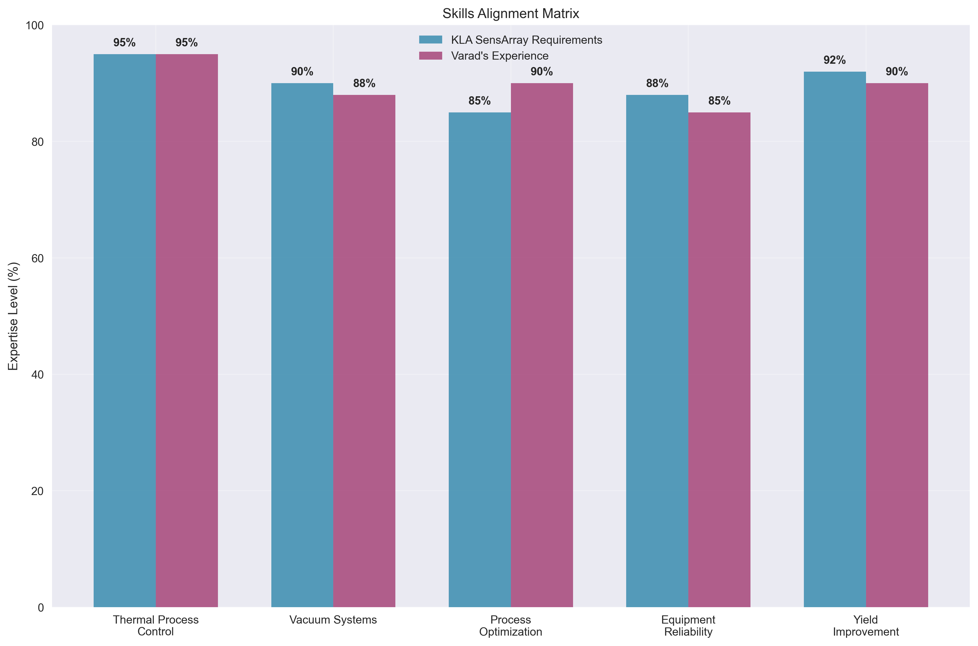
Alignment with KLA SensArray: In-Situ Thermal Process Control

Slide 8
Technical Skills & Tools
CAD DESIGN & SIMULATION:
• Revit, Siemens NX, ANSYS CFD/FEA (Icepak/Fluent)
• AutoCAD, SolidWorks, CATIA, Creo, Fusion 360, SimScale
DATA ANALYSIS & CODING:
• Python, MATLAB, JMP, SQL, DoE, SPC
• Power BI, Tableau, RCA, FMEA, SAP HANA
• PLC, HMI, G-code
THERMAL & VACUUM SYSTEMS:
• HVAC Design and Optimization
• Vacuum Deposition Equipment (CVD, PVD, ALD)
• Thermal Management and Heat Transfer
• Process Control and Automation
LEADERSHIP & COMMUNICATION:
• President of Employee Collaboration Club at TSMC
• Technical Public Speaker and Mentor
• Cross-functional Team Leadership
• Stakeholder Management and Training

Slide 9
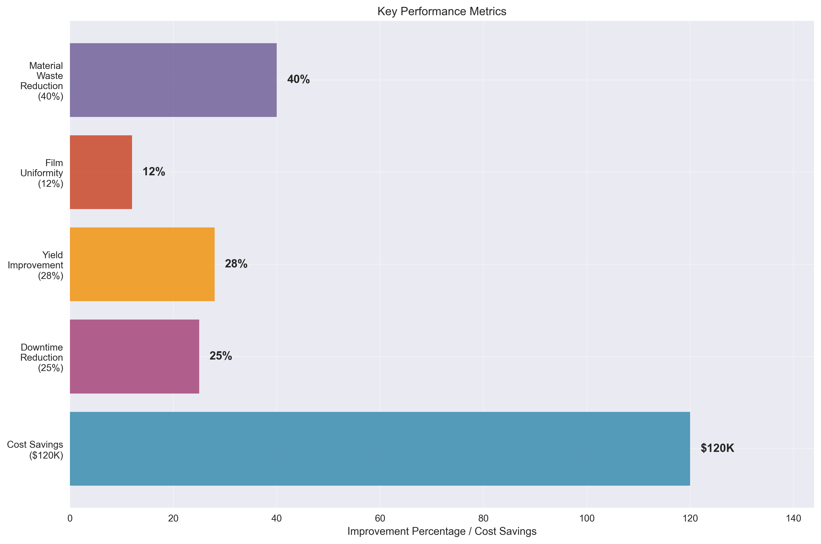
Quantified Impact & Achievements

Slide 10
Thank You & Questions
KEY VALUE PROPOSITION:
• Proven track record in thermal process control and vacuum systems
• Experience with semiconductor manufacturing and yield improvement
• Strong background in equipment reliability and process optimization
• Demonstrated leadership in cross-functional engineering teams
CONTACT INFORMATION:
• Email: vlad3@asu.edu
• Phone: 602-388-6861
• LinkedIn: linkedin.com/in/varadlad
• Portfolio: varadlad.github.io/varadlad-portfolio
AVAILABILITY:
• Available immediately
• Open to relocation
• Ready to contribute to KLA's innovative mission
Thank you for your time and consideration!

